Slide 1
INVESTMENT CASE STUDY SUBMISSION
Group Name:
Kapil Tekwani

Slide 2
Investment Case Study for Spark Funds
Design a investment strategy for an asset investment company Spark Fund..
Strategy should consider that investment amount should be between 5million to 15 million per round of investment.
Strategy should also make sure that investment should be made in English speaking countries.
Strategy should also evolve around the fact that we should try to invest where majority of investors are investing.

Slide 3
Problem solving methodology
Read the available data files like company.txt, round2.csv etc and load them in dataframes.
Merge the logically related dataframes based on set of common columns.
Clean the dataset by removing null values from columns which will be used for analysis, example: ‘raised_amount_usd’
Filter the dataset to get list of countries in which most of the investment has been made based on the total investment sum of money invested in each country.
Then calcalute the sectors within each country where maximum number of investments have been made within a country to get the list of sectors where other investors are investing money with respect to each country.
6) Once we get list of sectors with respect to each country which are attracting maximum number of investment, we can find list of companies among those sectors attracting maximum number of investments within their sectors.
7) In this way we will get the list of companies of different sectors of different countries where we can invest our money.

Slide 4
Analysis
The Funding Type in which Spark Fund should invest is ‘venture’ funding type because the average funding amount for ‘venture’ type is 10634050 USD which lies between 5 to 15 million USD. Funding Type ‘undisclosed’ also follows this requirement but we had to choose between venture, angel, seed and private_equity. Hence, our data analysis says that Spark Funds should invest in venture funding.
Top 3 countries in which Spark Funds can think of investing in are as follows:
Note: Top 9 list includes other countries too but below 3 are top English speaking countries as required by Spark Funds)
USA- United States
GBR – United Kingdom
IND – India
Among the above mentioned countries, Spark Fund should also take into account the main sectors in which they want to invest in these countries. For this requirement, they can consider sectors in which maxium number of invest ments are being made. One the group of sectors for investment is decided, we can look forward to list of companies which are getting maximum number of investments within their corresponding main sectors.

Slide 5
Analysis
Top 3 sectors in the above countries in which Spark Funds can think on investing in(Top 3 are found on the basis of number of investments in main sectors)
USA – Unites States of America
Others , Social, Finance, Analytics, Advertising & CleanTech/Semiconductors
Company with Highest Number of investmest in Others sector – VirtuStream
Company with Highest Number of investmest in Social, Finance, Analytics, Advertising sector – Shotspotter
Company with Highest Number of investmest in CleanTech/Semiconductors - Biodesix
GBR – United Kingdom
Others , Social, Finance, Analytics, Advertising & CleanTech/Semiconductors
Company with Highest Number of investmest in Others sector – Electic Cloud
Company with Highest Number of investmest in Social, Finance, Analytics, Advertising sector – CellTick Techno.
Company with Highest Number of investmest in CleanTech/Semiconductors – Eusa Pharma

Slide 6
Analysis
India –
Others , Social, Finance, Analytics, Advertising & News, Search and Messaging
Company with Highest Number of investmest in Others sector – FirstCry.com
Company with Highest Number of investmest in Social, Finance, Analytics, Advertising sector – Manthan Systems
Company with Highest Number of investmest in News, Search and Messaging– GupShup Technologies Pvt. Ltd
Thus going by the analysis done above, Spark Fund should focus on investing in countries like USA, GBR, India and main sectors like Others, Social, Finance, Analytics, Advertising, CleanTech /Semiconductors and News, Search and Messaging.

Slide 7
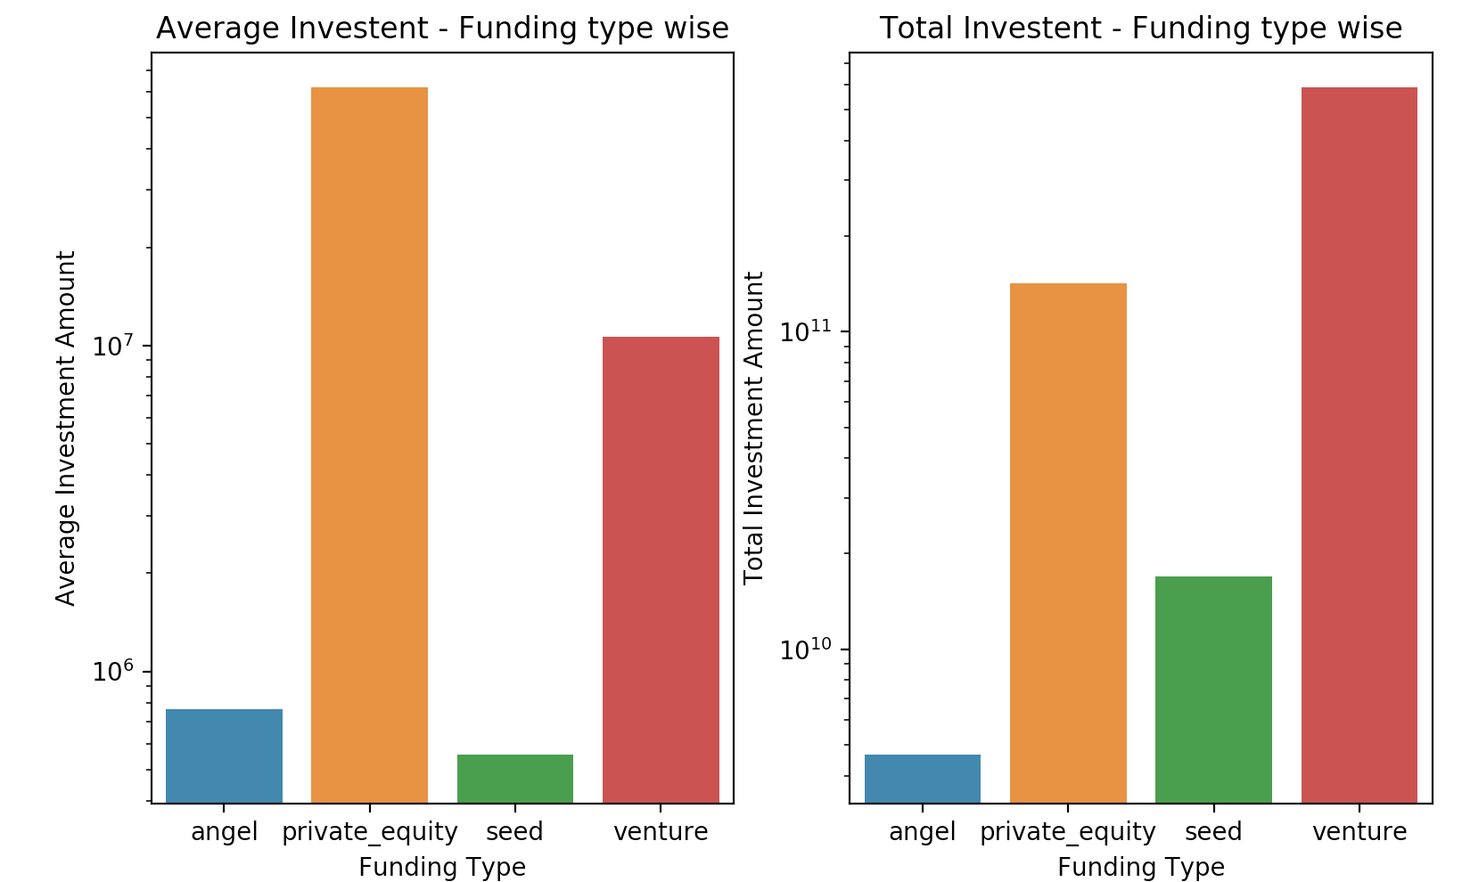
<Results>
Plot 1

Slide 8
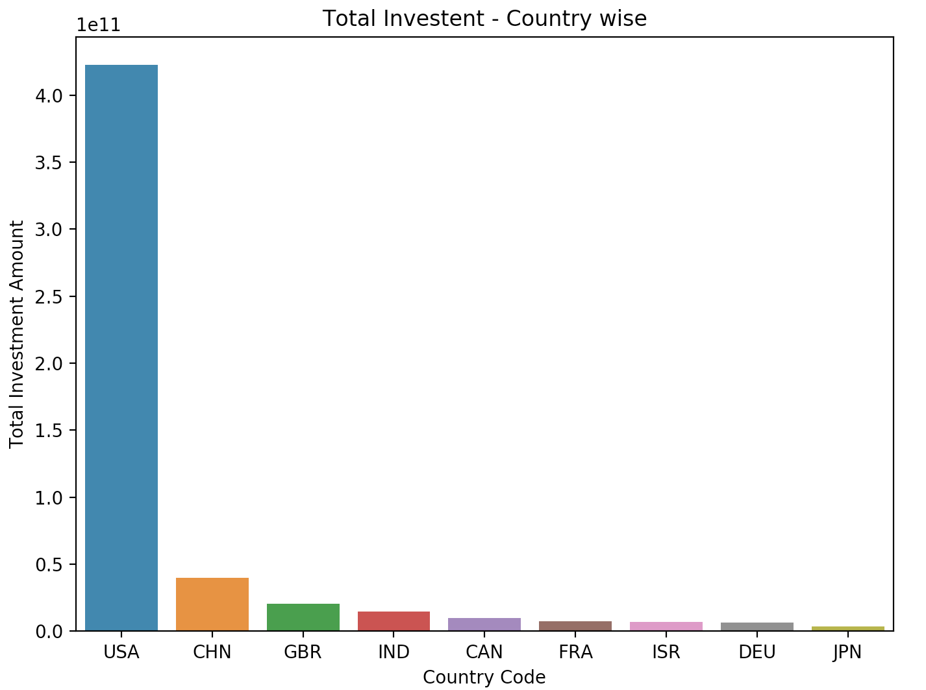
esults>
Plot 2

Slide 9
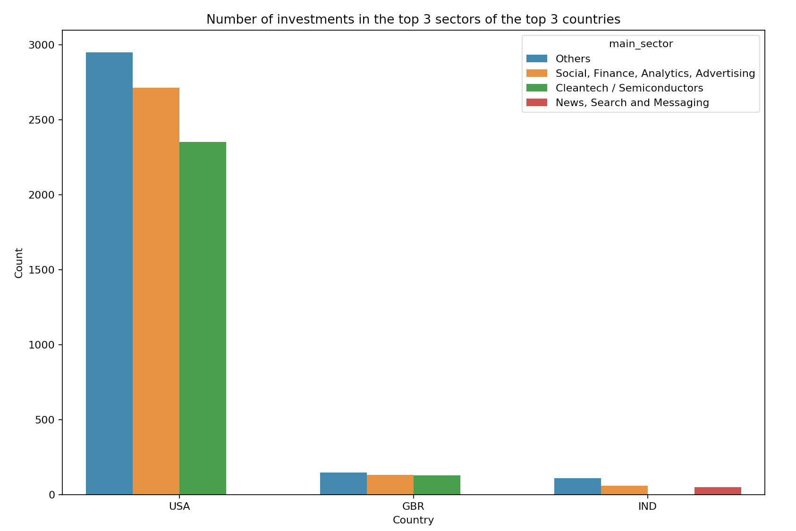

Slide 10
<Conclusions>
From the Plot 3, we have see that investment companies are heavily investing in US.
Investment in US is almost more than 10 times of what has been invested in GBR/India.
In US, “Others”, “Social, Finance, Analytics, Advertising” & “CleanTech/Semiconductors” are the top three sectors in which investors are investing based on number of investments made
In GBR, “Others”, “Social, Finance, Analytics, Advertising” & “CleanTech/Semiconductors” are the top three sectors in which investors are investing based on number of investments made.
In India, “Others”, “Social, Finance, Analytics, Advertising” & “News, Search & Messaging” are the top sectors in which investors are investing based on number of investments made.
Total Investment amount is huge in venture and private-equity type fundings out of which venture funding scheme captures the first positions.
Total Investment made in different funding_round_types in decresing order is as follows: Venture, Private Equity, Seed and last comes Angel.

